Slide 1
Proposed Method
five convolutional layers, with each being followed by batch normalization and max pooling layers, along with dropout. Processing the final convolutional layer is a fully connected layer with 512 neurons, followed by the last layer with three neurons representing each category of X-ray. ReLU was used as the activation function for each layer, and softmax was used for the final dense layer

Slide 2
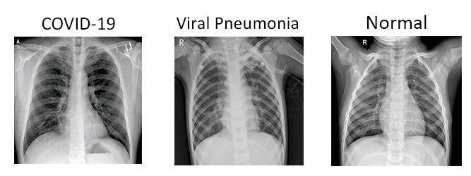
Our Dataset: COVIDx CXR-2
30,000 CXR images from a multinational cohort of over 16,600 patients diagnosed with Covid-19, pneumonia or healthy.
3000 images only were used due to our limited hardware capabilities.
Dataset was balanced by randomly choosing 1000 image from each class.
60% of the data were used for training, 20% were used for validation and 20% were used for with 1800 images being part of the training set and 600 images being part of the validation set and test set.

Slide 3
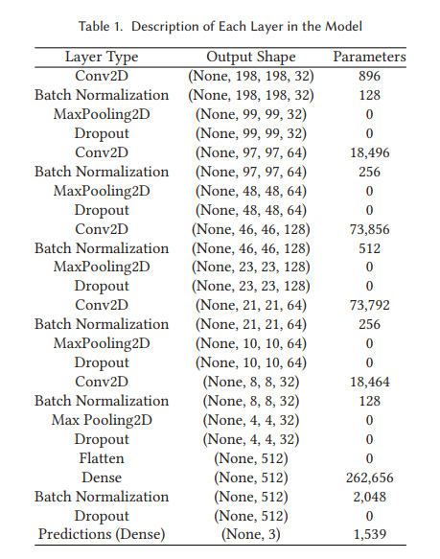

Slide 4
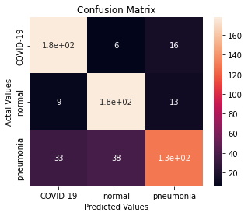
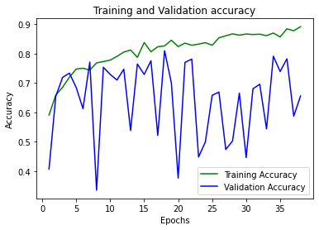
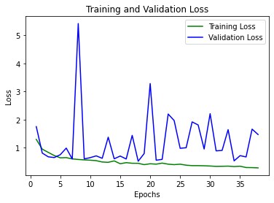
Results
precision recall f1-score support
COVID-19 0.81 0.89 0.85 200
normal 0.80 0.89 0.84 200
pneumonia 0.82 0.65 0.72 200
accuracy 0.81 600
macro avg 0.81 0.81 0.80 600
weighted avg 0.81 0.81 0.80 600

